Slide 1
Week 1: Calculus in Data Science
Rabail Tahir

Slide 2
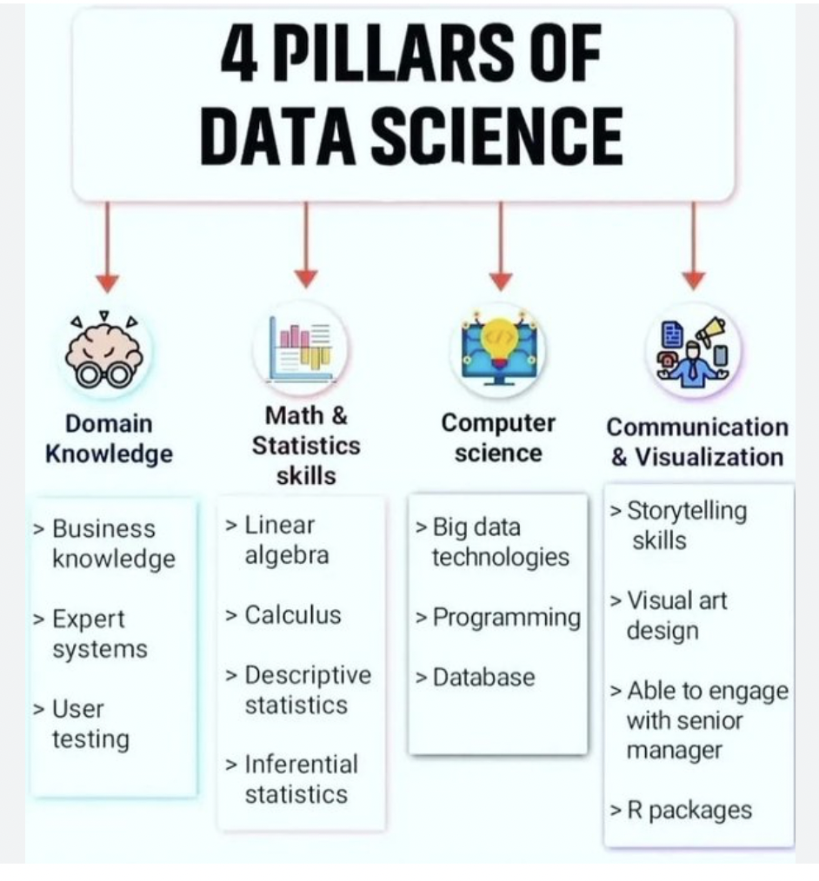
https://www.kaggle.com/discussions/getting-started/352351

Slide 3
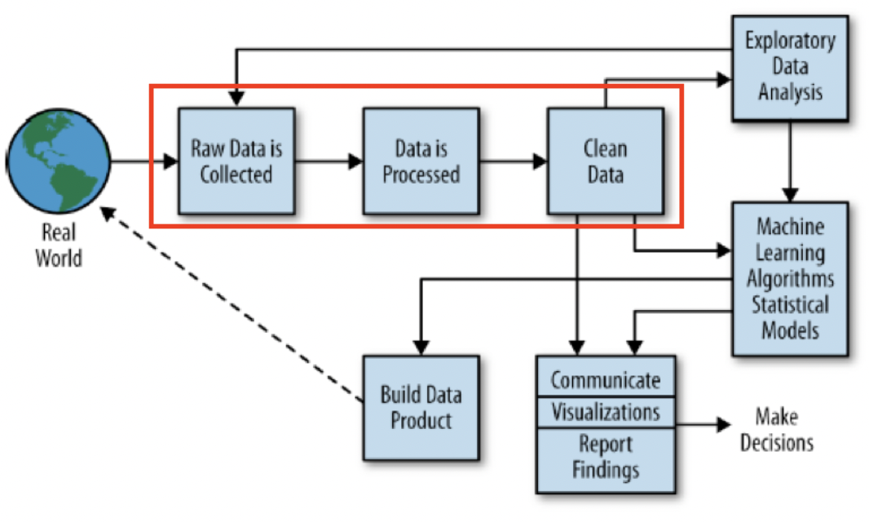
The Data Science Process
Source: Doing Data Science
Rachel Schutt & Cathy O’Neil

Slide 4
Recommended Books
Applied Calculus 5th Edition:
https://learning.oreilly.com/library/view/applied-calculus-5th/9781118174920/
Essential Math for Data Science:
https://learning.oreilly.com/library/view/essential-math-for/9781098102920/

Slide 5
Mathematics in Data Science
Calculus
Statistics
Probability
Linear Algebra

Slide 6
What is Calculus?
"Calculus is a branch of mathematics that involves the study of rates of change"
It is derived from the word "Calculi" , which means pebbles.
It is the tracking of small changes.

Slide 7
Application of Calculus in Data Science
Some of the concepts in Calculus are used to study changes and are applied in Machine learning algorithms.
Calculus concepts to be covered in this lecture:
Number theory
Equations, Functions
Logarithm, exponential, polynomial functions, rational numbers.
Basic geometry and theorems, trigonometric identities.
Real and complex numbers and basic properties.
Series, sums, and inequalities.
Graphing and plotting, Cartesian and polar co-ordinate systems, conic sections.
Differentiation/ Integration

Slide 8
Number Theory and Number Systems
Number Theory is the study of Number systems. We need Number systems we understand the numbers around us.
Number systems summary:
Natural Numbers (1,2,3,4,5...) [Only positive numbers are included]
Integers ( …-2,-1,0,1,2...) [ Positive and Negative natural numbers including 0]
Rational Numbers (p/q where q is not equal to 0, any number that can be expressed as a fraction
Irrational Numbers
Irrational numbers cannot be expressed as a fraction. This includes the famous π, square roots of certain numbers.

Slide 9
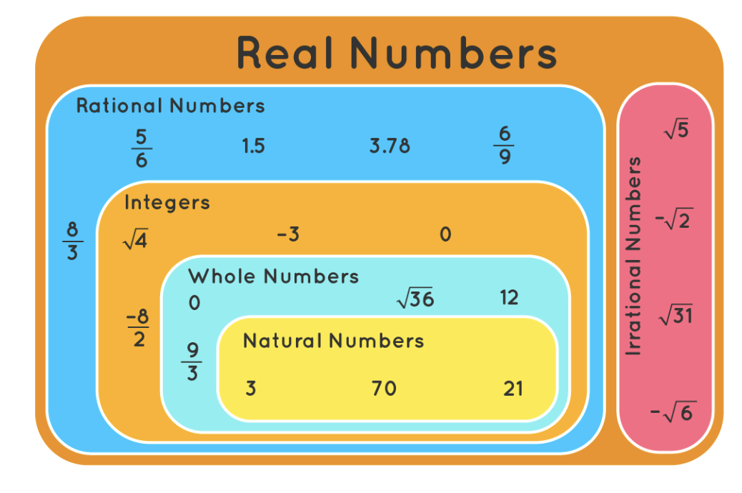

Slide 10

Order of operations
Ordering parentheses, exponents, multiplication, division, addition, and subtraction.
For example consider this expression:

Slide 11
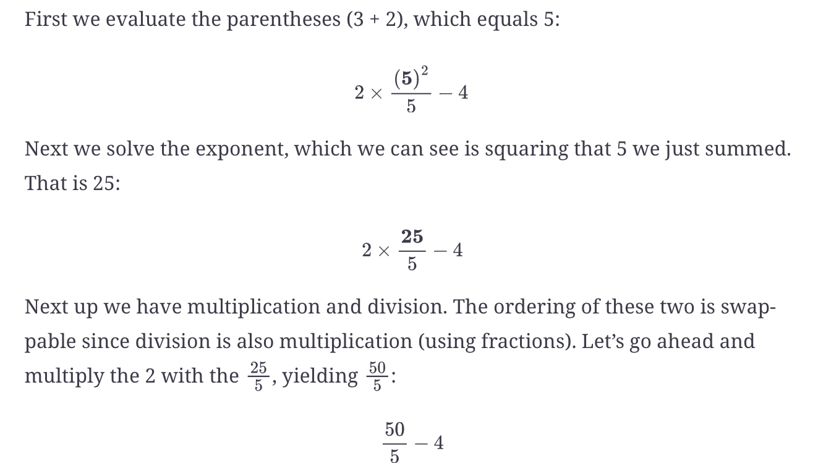
Order of Operations

Slide 12
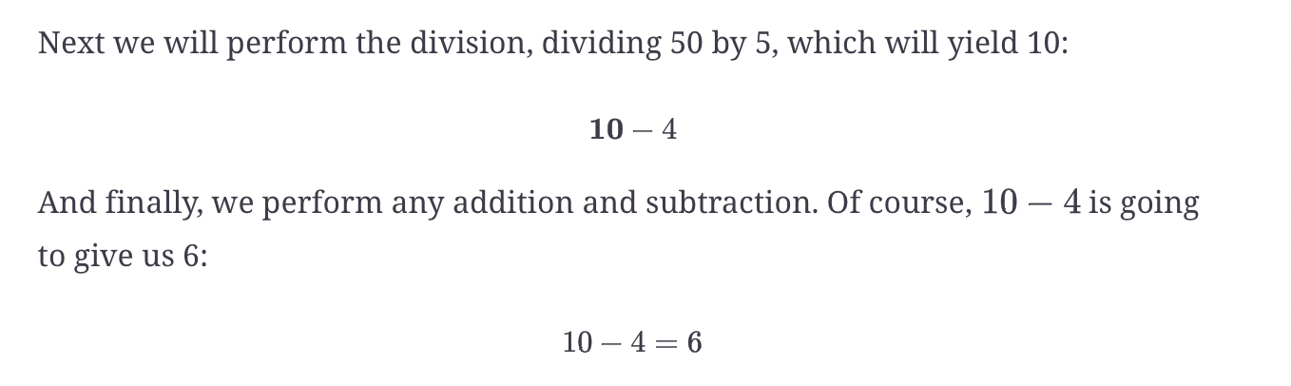
Order of Operations contd

Slide 13
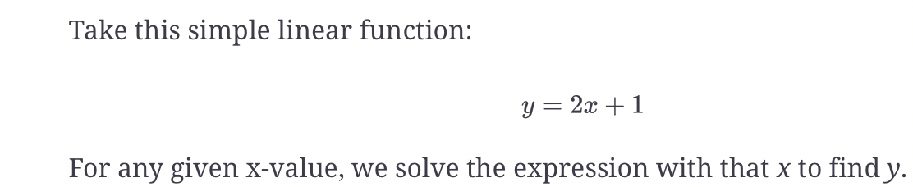
Functions
Variables are named values/quantities
Function is defined as the relationship between 2 or more variables.

Slide 14
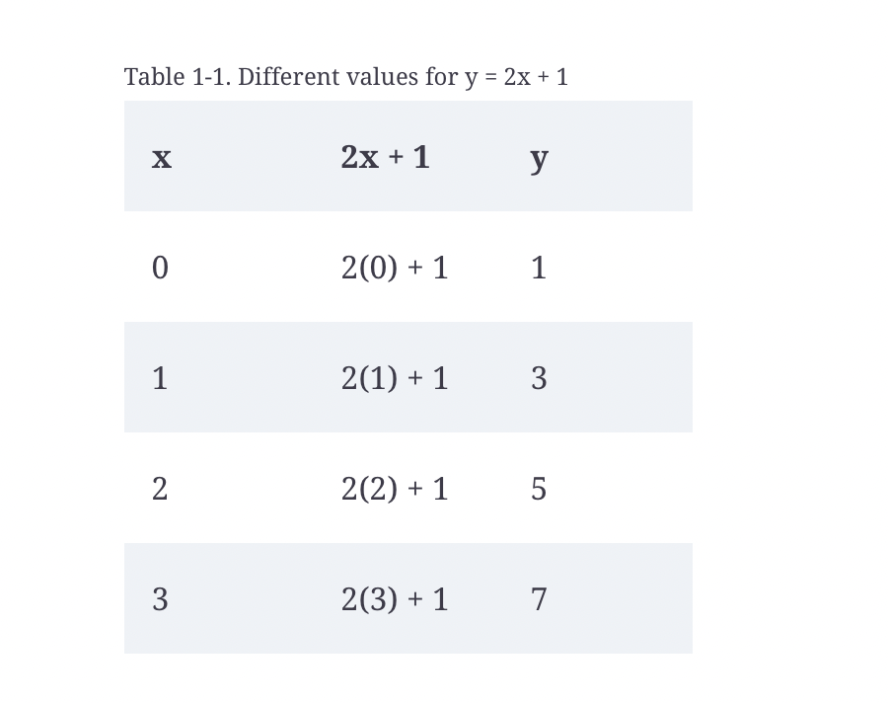
Functions

Slide 15
What are Functions used for in Data Science?
Functions are useful because they model a predictable relationship between variables, such as how many fires y can we expect at x temperature.

Slide 16
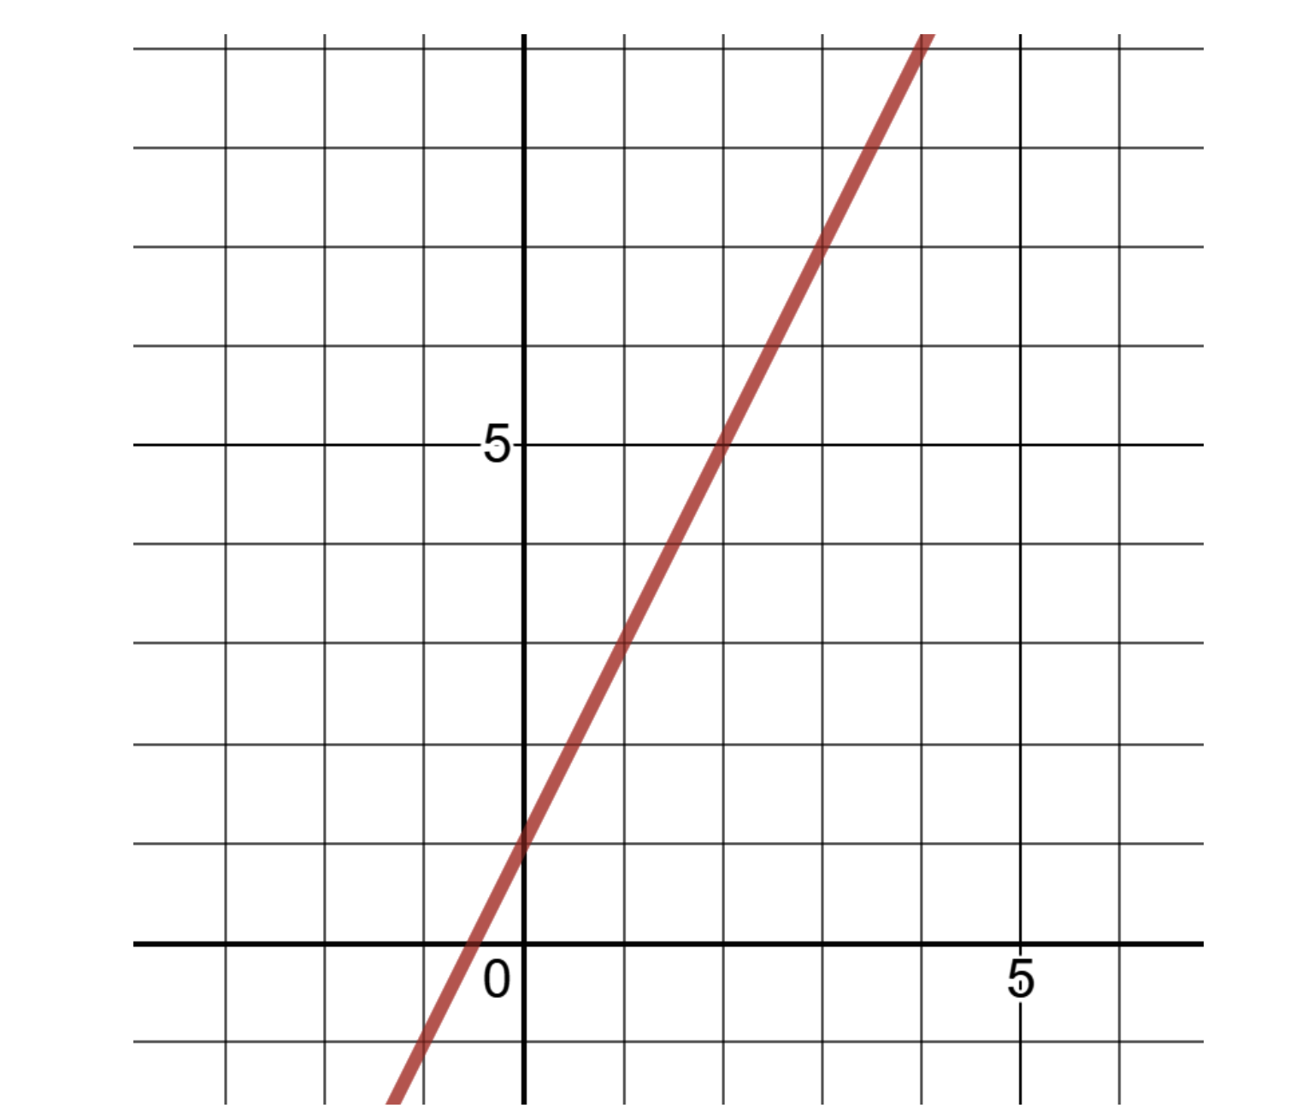
Visualizing the Function
Visualizing the function means to plot on a two-dimensional plane with two number lines (one for each variable) it is known as a Cartesian plane, x-y plane, or coordinate plane.

Slide 17
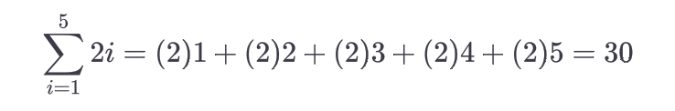
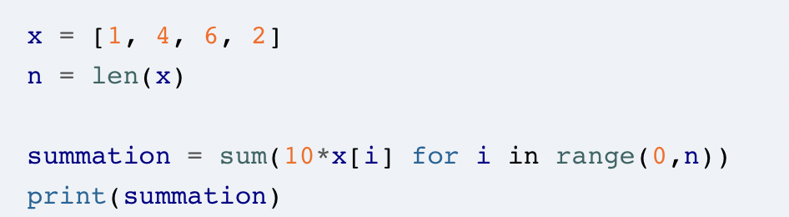
Summations
A summation is expressed as a sigma Σ and adds elements together.
For example:
Python code for summation:

Slide 18
Exponents
Exponents multiply a number by itself a specified number of times.
The base is the variable or value we are exponentiating, and the exponent is the number of times we multiply the base value. For the expression 23, 2 is the base and 3 is the exponent.

Slide 19
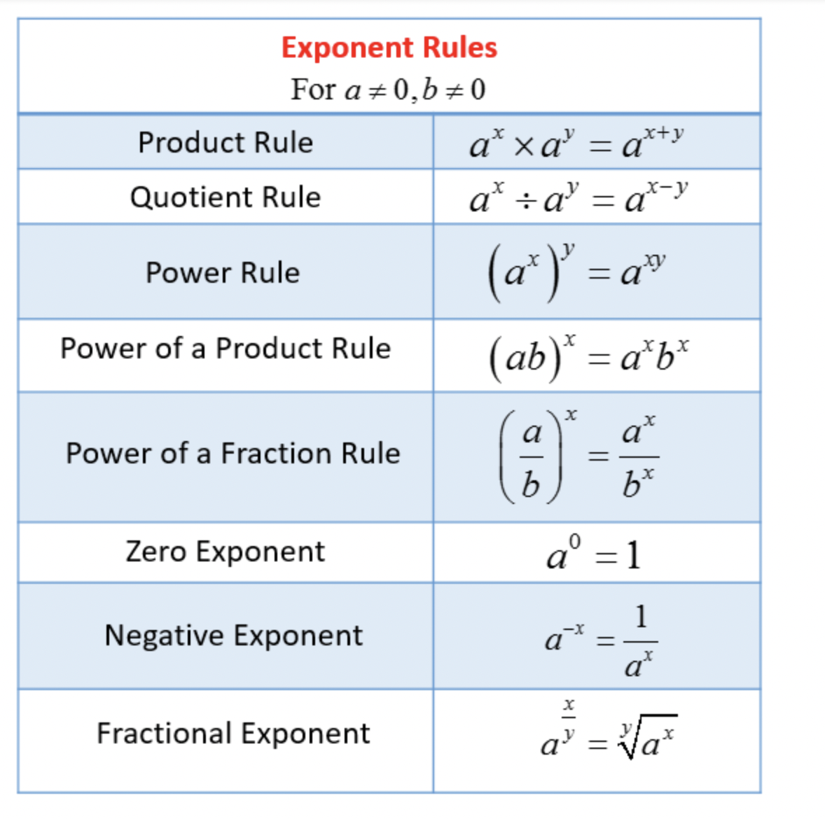
Rules of Exponent

Slide 20
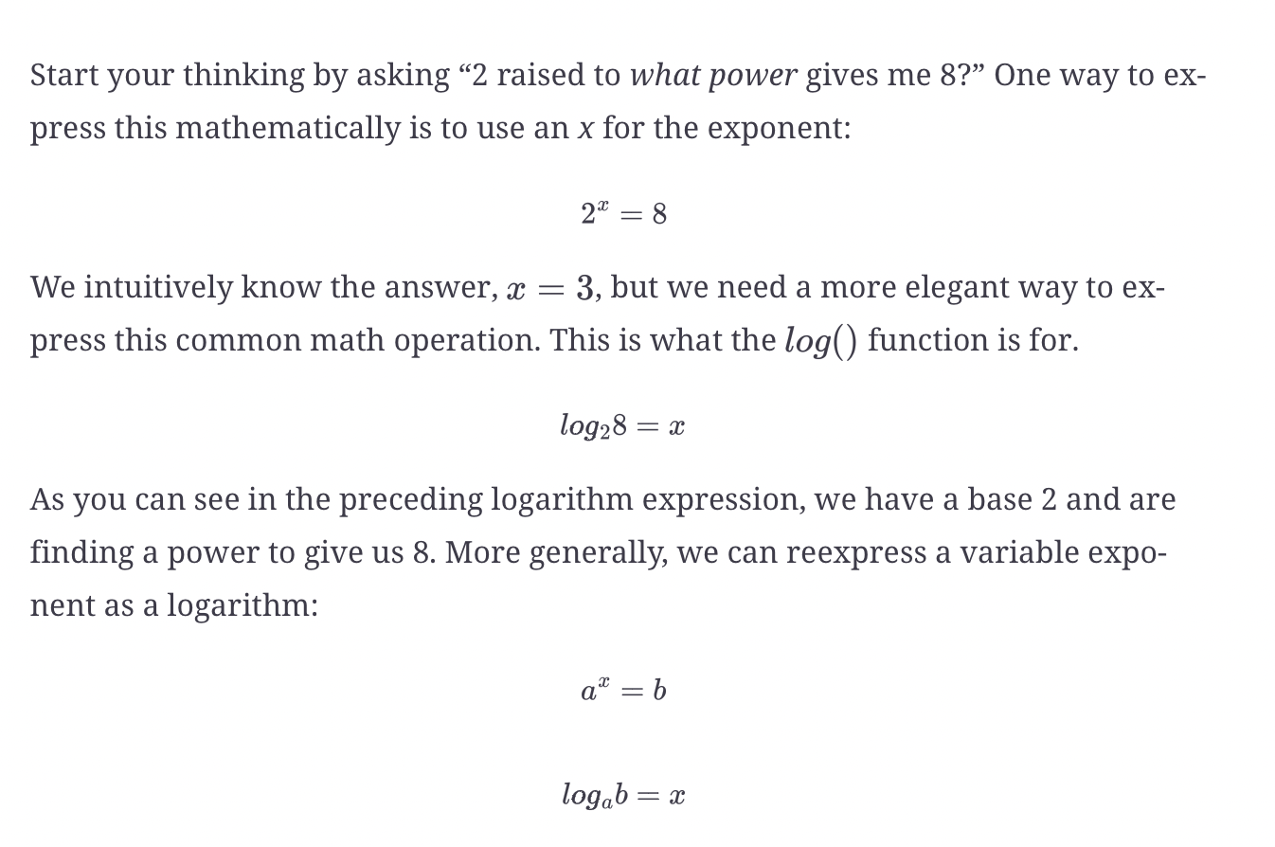
Logarithms
A logarithm is a math function that finds a power for a specific number and base.

Slide 21
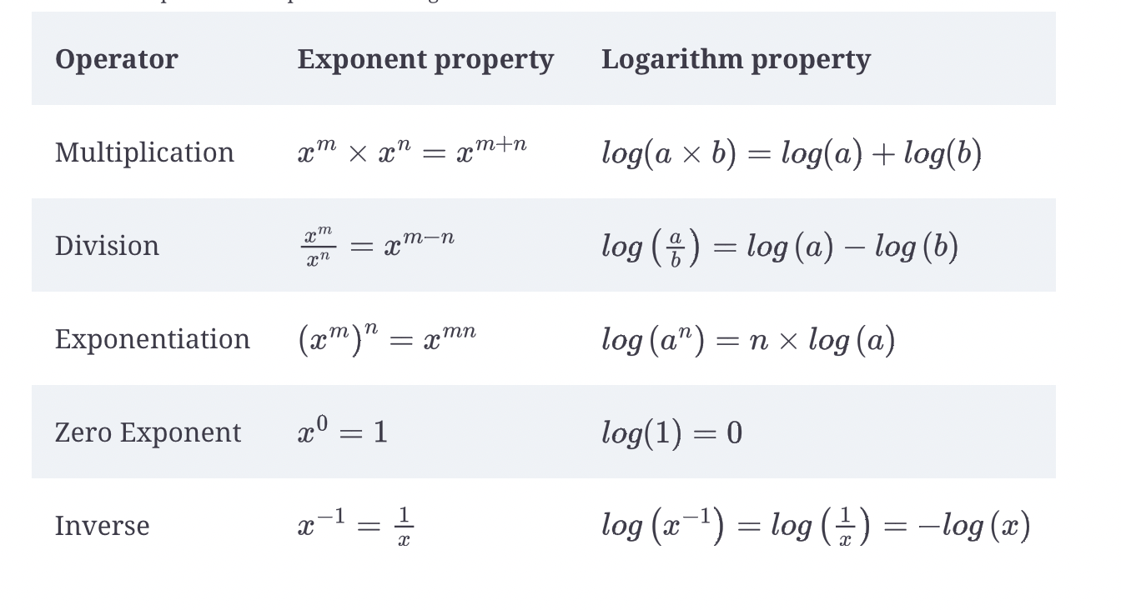
Properties for exponents and logarithms

Slide 22
Euler's number and natural logarithms
Euler's number is a special number just like pie and has a value of 2.71828
A property of Euler’s number is its exponential function is a derivative to itself, which is convenient for exponential and logarithmic functions.
When we use e as our base for a logarithm, we call it a natural logarithm. Depending on the platform, we may use ln() instead of log() to specify a natural logarithm. So rather than express a natural logarithm expressed as loge10 to find the power raised on e to get 10, we would shorthand it as ln(10).

Slide 23
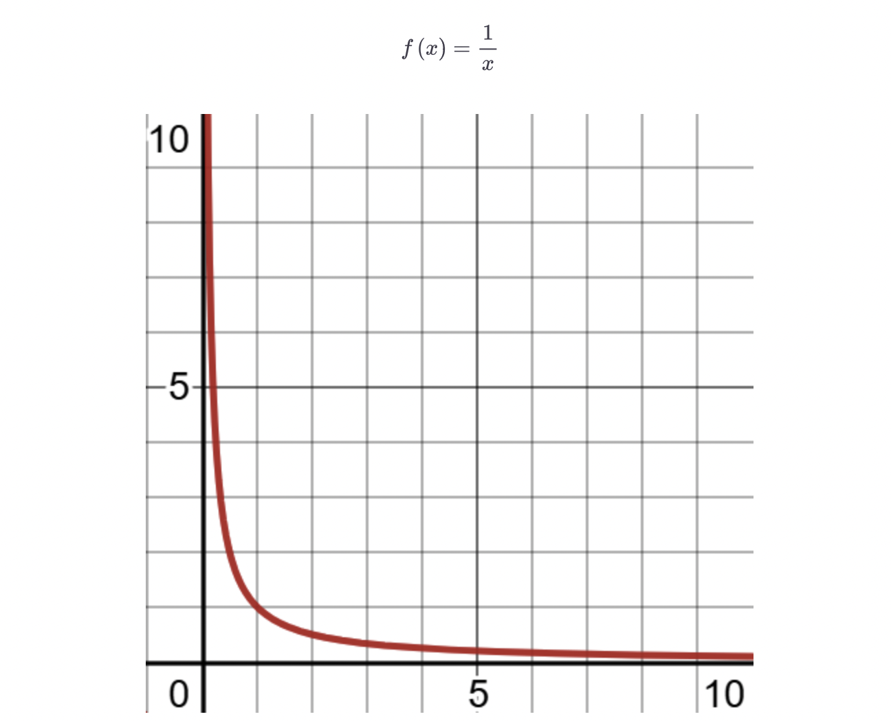
Limits
"Limits in maths are defined as the values that a function approaches the output for the given input values"

Slide 24
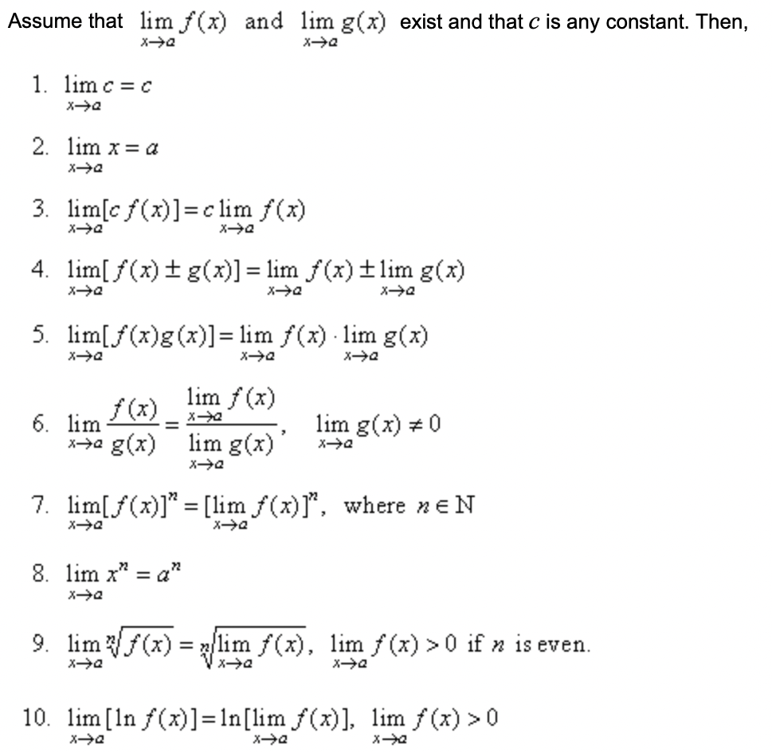
Laws of Limits

Slide 25
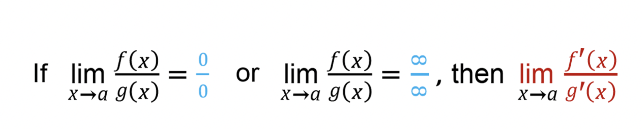
L’Hopital’s Rule

Slide 26
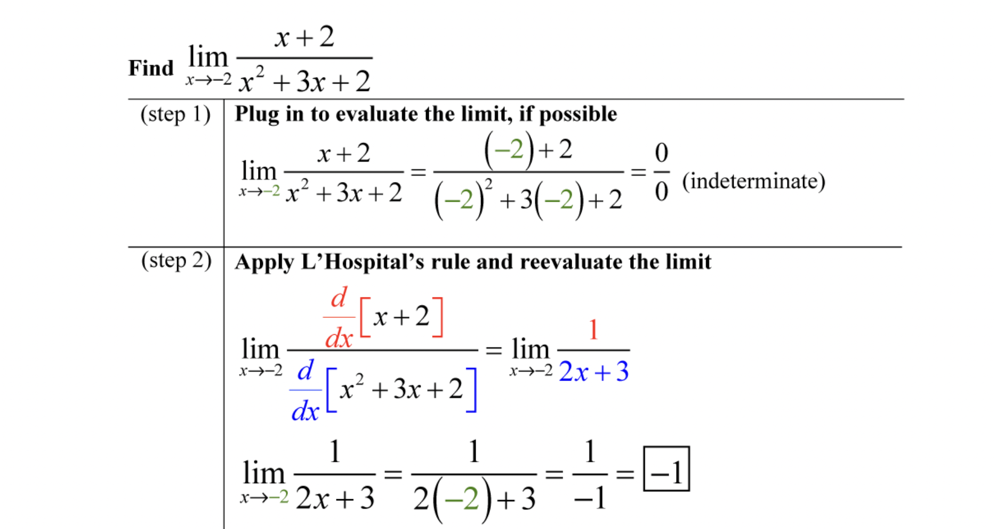
Example

Slide 27
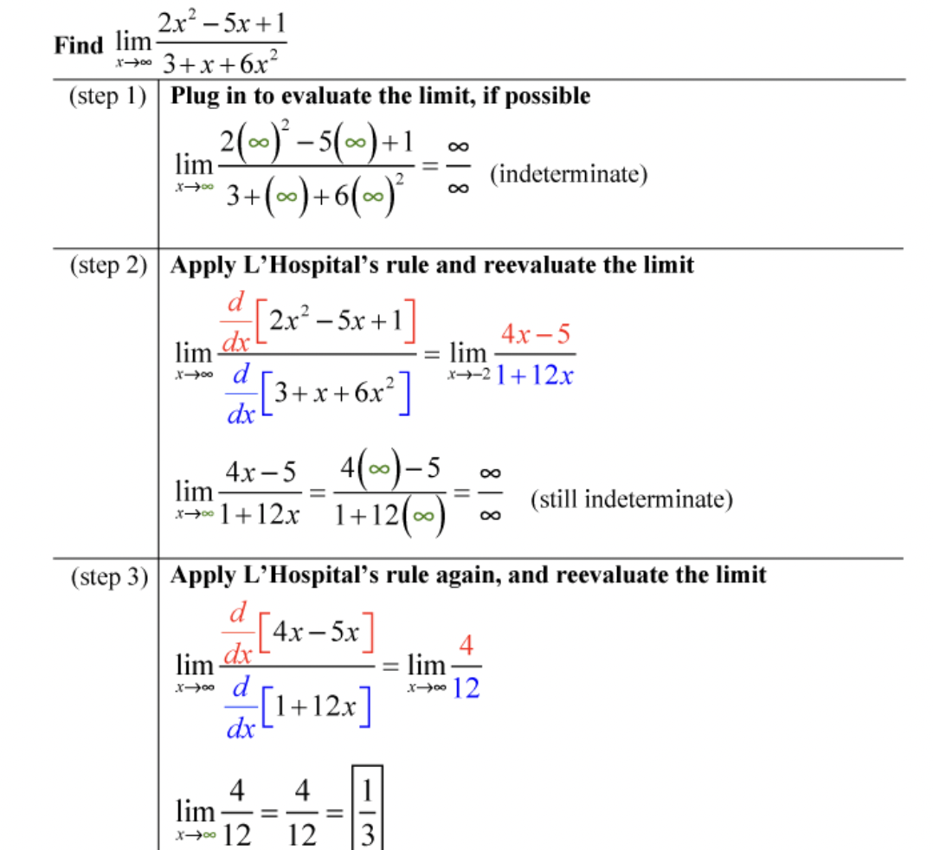
Example

Slide 28
Derivatives
"A derivative tells the slope of a function, and it is useful to measure the rate of change at any point in a function."
Derivatives are used in machine learning and various mathematical algorithms.
A tangent is a line which touches a given function on any given point and tells us about the slope of a function on that particular point.
We use this concept to cut the function into small pieces to study how it changes.

Slide 29
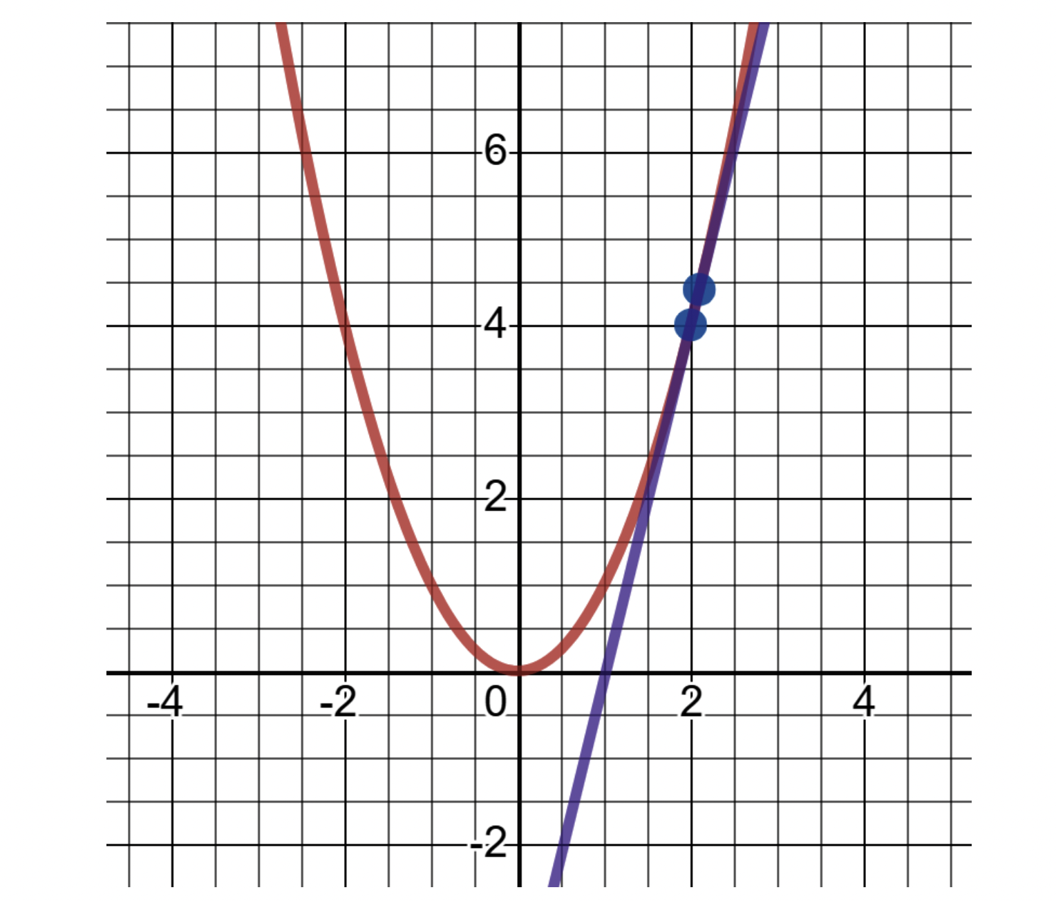

Calculating Slope
Consider this graph for the function f(x)= x^2
To calculate the slope m at the point of intersection

Slide 30
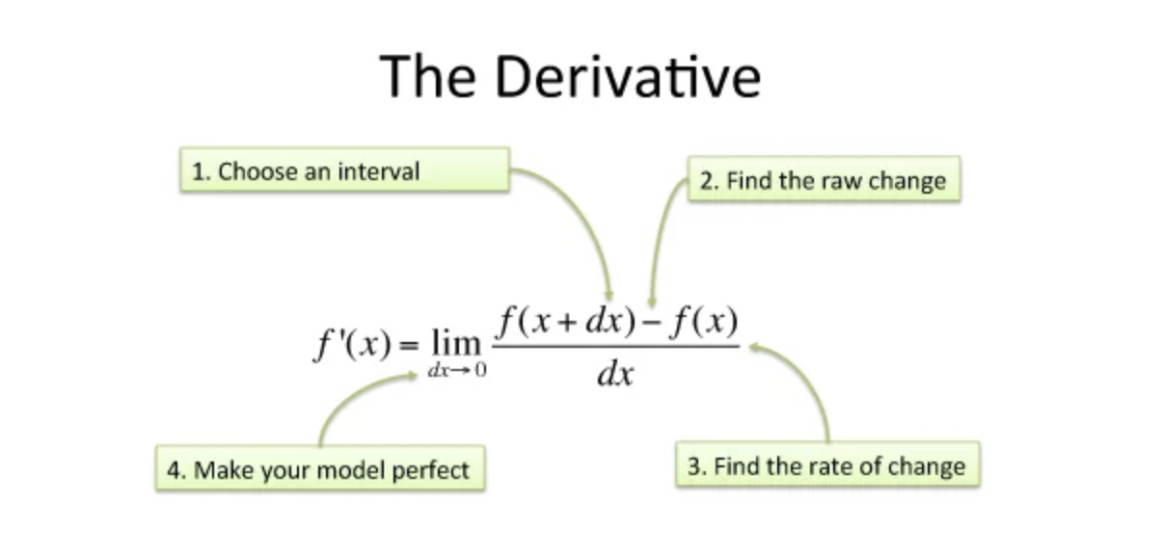

Slide 31
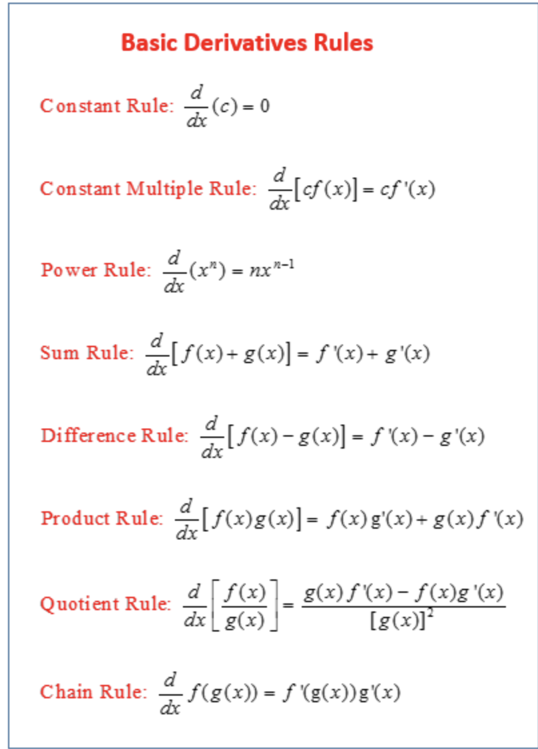

Slide 32
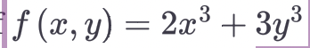
Partial Derivatives
Partial Derivatives deal with functions that have multiple input variables.
Rather than finding the slope on a one-dimensional function, we have slopes with respect to multiple variables in several directions
And for each variable derivative, we assume that the others are being held constant.
Let's look at a 3D graph of the function

Slide 33
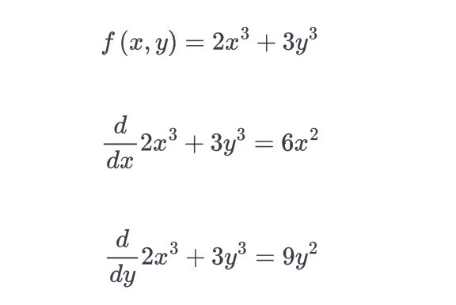
Calculating derivatives of x and y

Slide 34
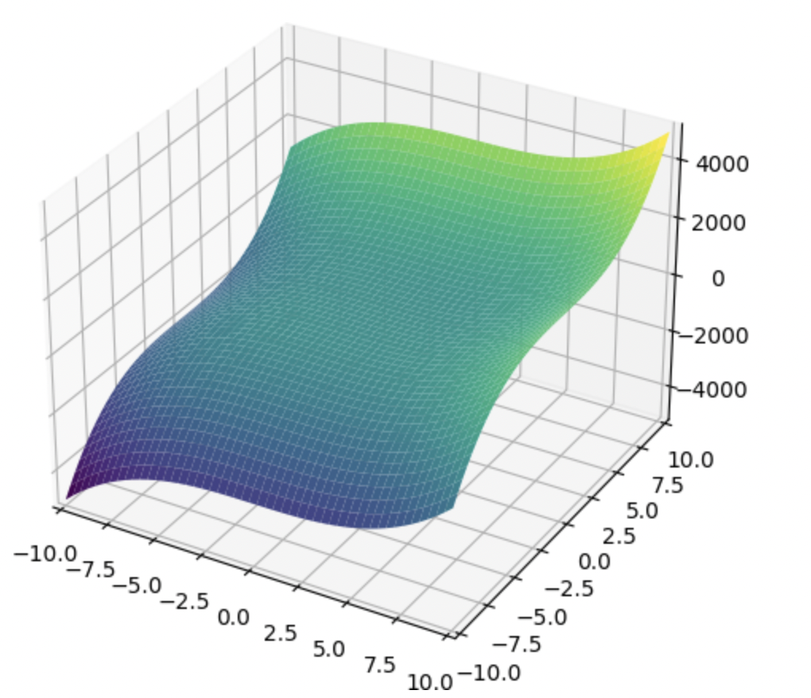

Slide 35
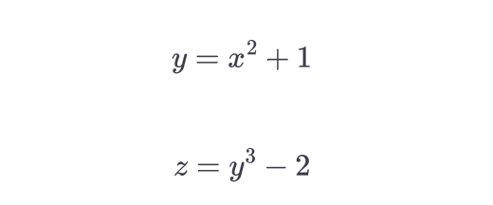
The Chain Rule
The Chain rule is useful in building neural networks.
Suppose you have 2 functions:

Slide 36

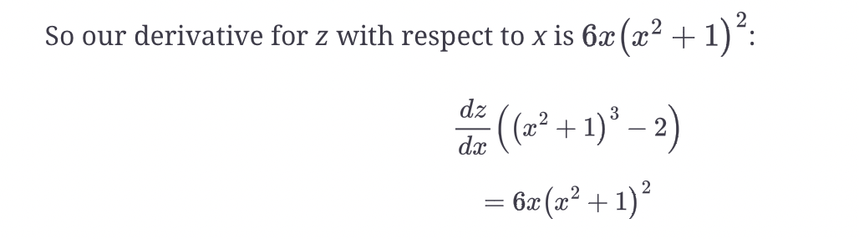
The Chain rule
Both functions are linked as the y variable is common between them.
We then substitute for y

Slide 37

The Chain rule

Slide 38
Integrals
The opposite of derivative is an integral
It is used to find the area under the curve for a given range
For example, we have function f(x) = 2x and we want to find the area between 0 and 1

Slide 39
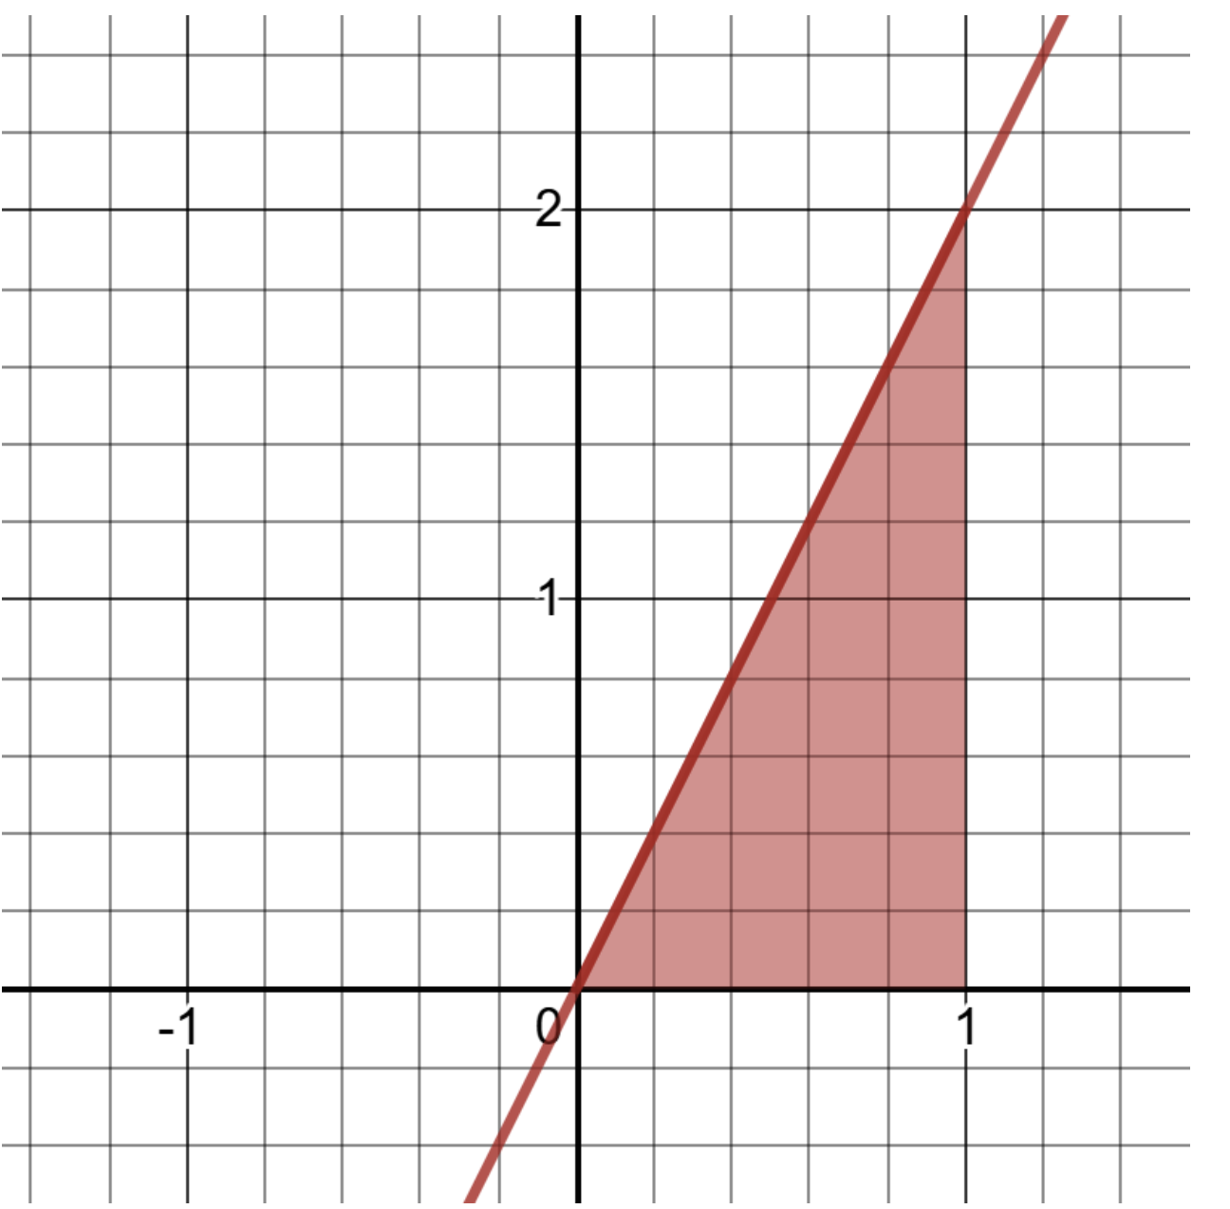

Slide 40
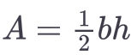
If you recall basic geometry formulas, the area A for a triangle is
where b is the length of the base and h is the height. We can visually spot that b=1 and h=2. So plugging into the formula, we get for our area 1.0.

Slide 41
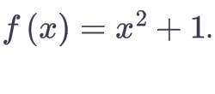
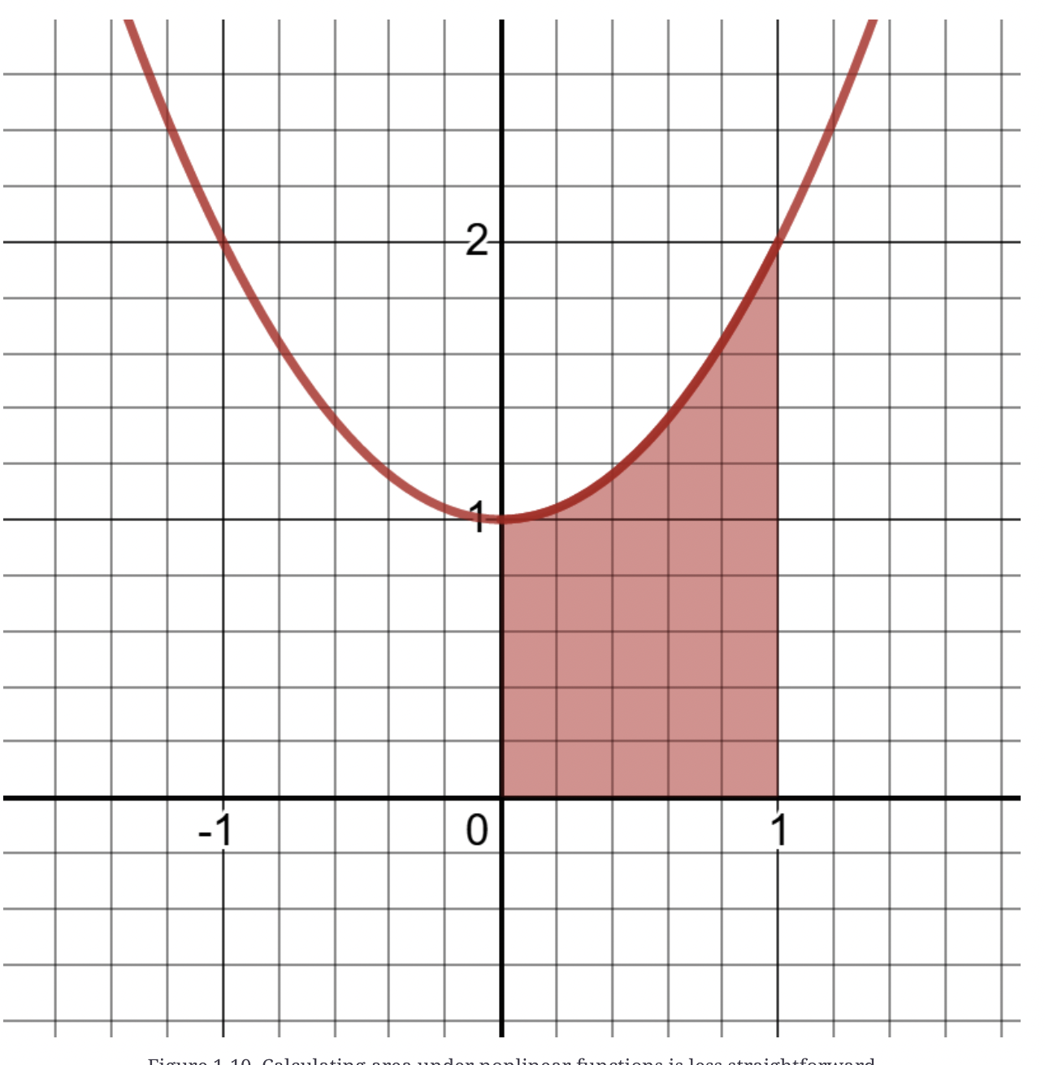
What is the area between 0 and 1, as shaded in this case?

Slide 42
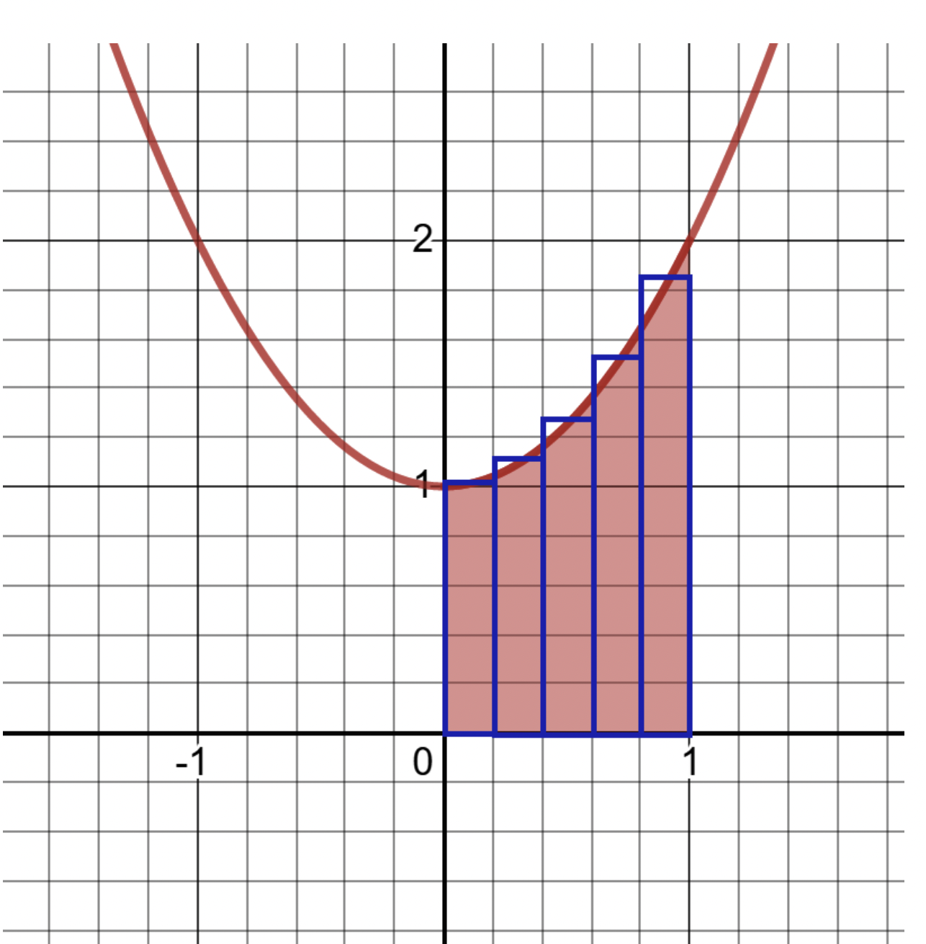
The area of a rectangle is A=length×width, so we could easily sum the areas of the rectangles. Would that give us a good approximation of the area under the curve?

Slide 43
Any questions?

